Slide 1
POLONIA CENTRE (WINDSOR) INC.WEBSITE
Information source about cultural,
educational & charitable events in and
for the Polish Community of Windsor
ADDRESS: www.poloniawindsor.ca
Prepared by: M. Wojewnik
Oct. /02/2014

Slide 2
ADDRESS: www.poloniawindsor.ca
FEATURES:
Events Calendar
Important announcements published as Posts
Organizations Pages
Latest news from Poland in English, Polish radio
Subscribe option to receive the newest posts
Contents Submission form and contact info

Slide 3
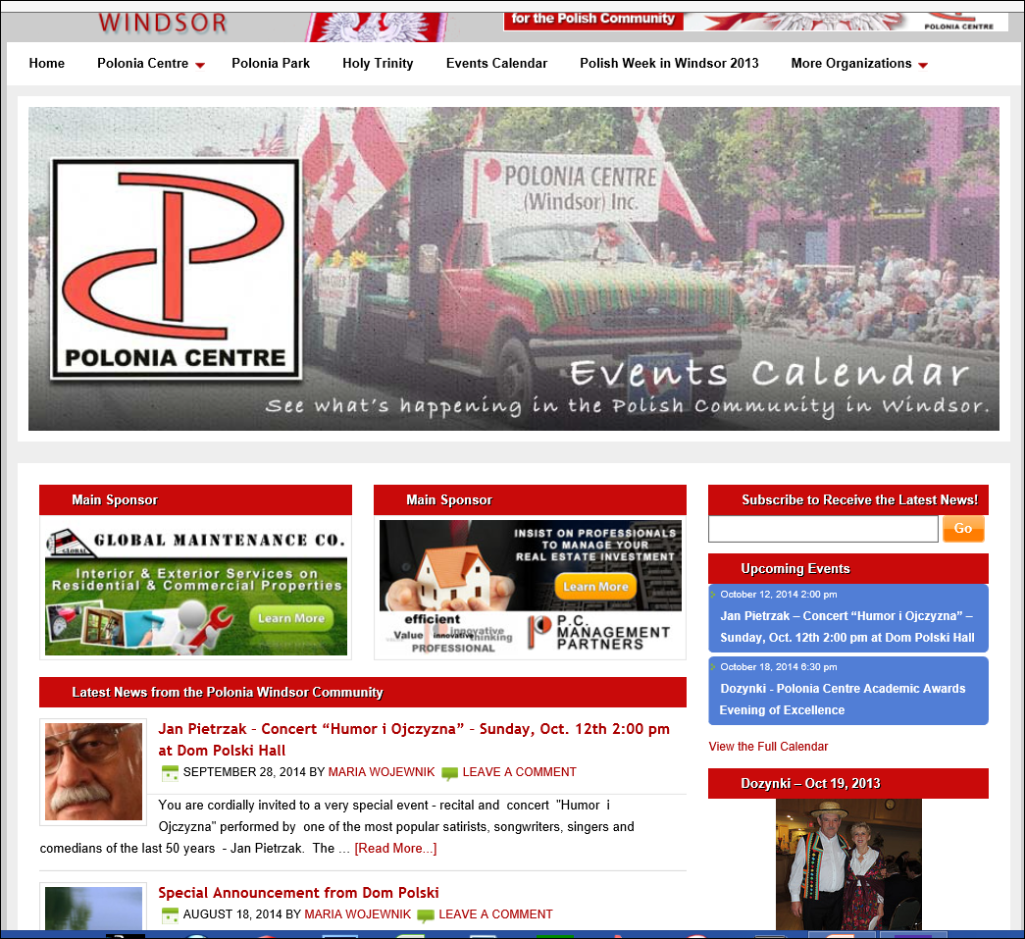
PoloniaWindsor.ca - Home page features
Polonia Centre
(Windsor) Inc.
Pages tab
Other Polish
Organizations tab
Click anywhere in
this area to open
Events Calendar
Links to Main
Sponsors Web
sites
Press orange
“GO” button for
subscribing new
Posts via email
Upcoming Events
- click on the blue
rectangle to view
the listed event
Time sensitive announcements are published as Posts in the centre of the Home page and in the Events Calendar

Slide 4
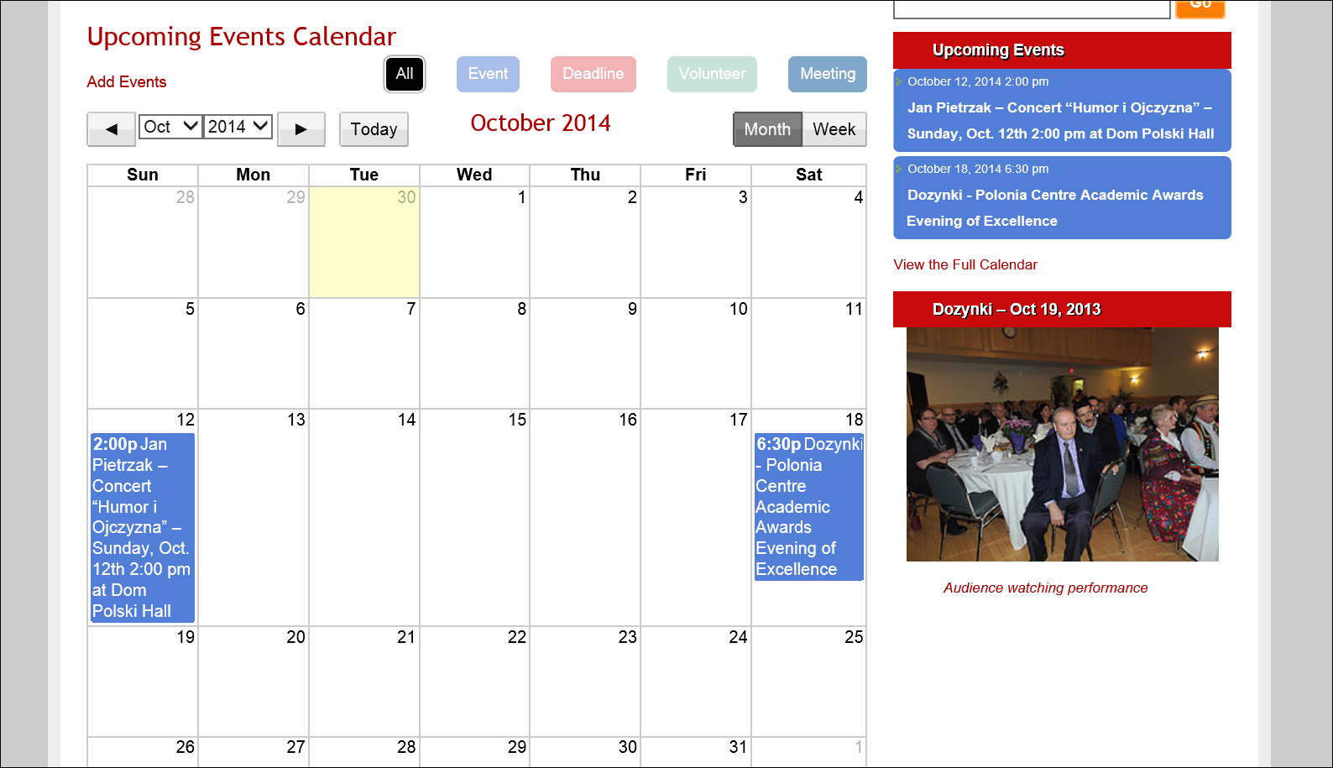
Events Calendar page – opens the whole page for the current month
The details of the event can be viewed by clicking in these two spots

Slide 5
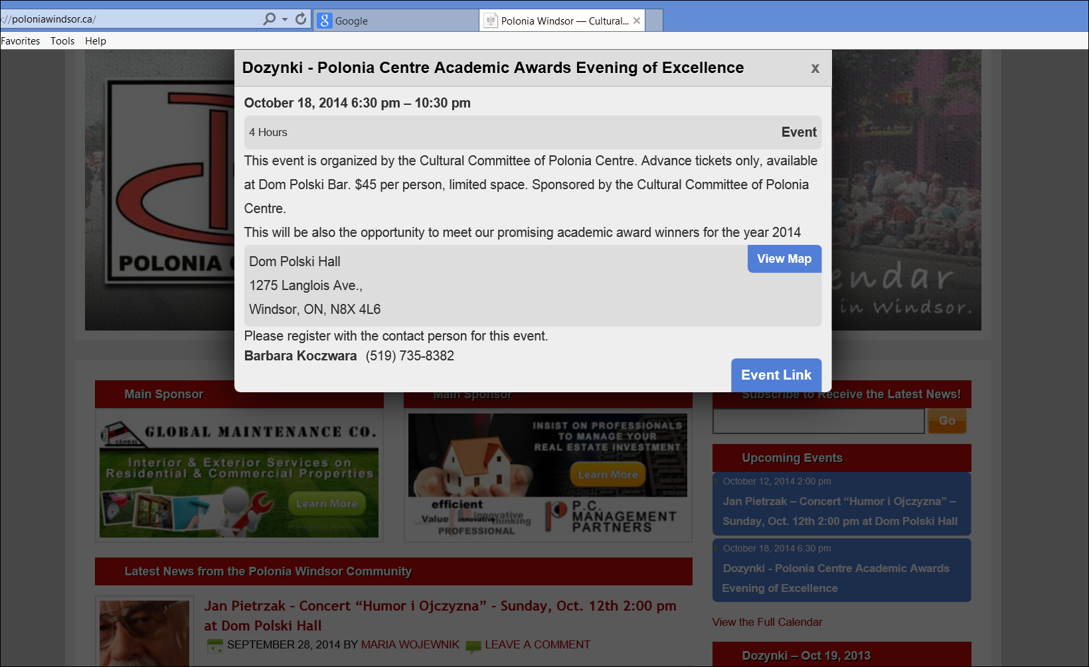
Open Upcoming Event window
Link to additional information page regarding the event
Location link with
map & address

Slide 6
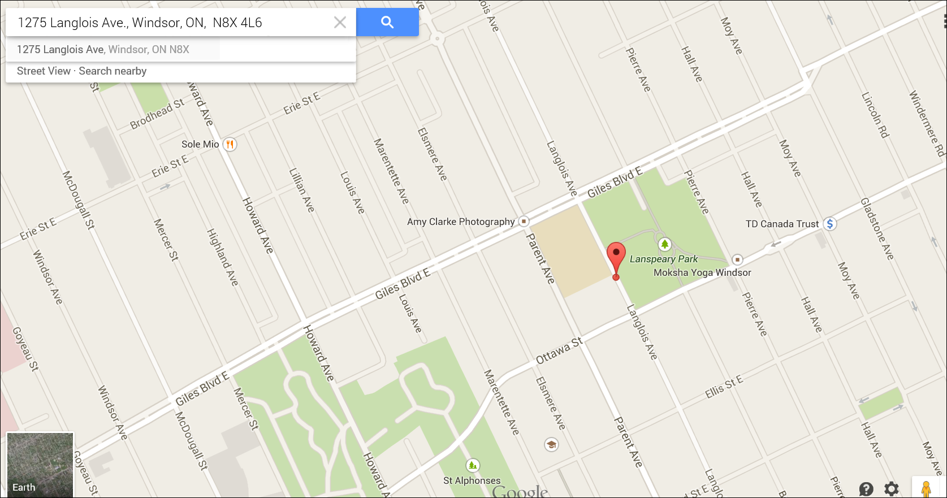
View Map button – link to location and address

Slide 7
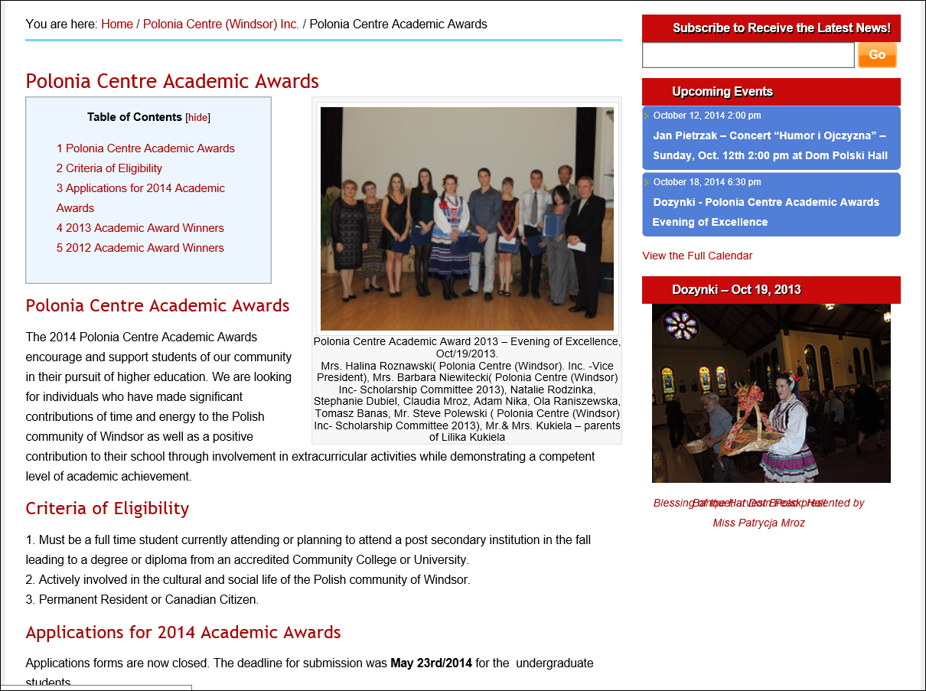
Event Link button – brings additional information page

Slide 8
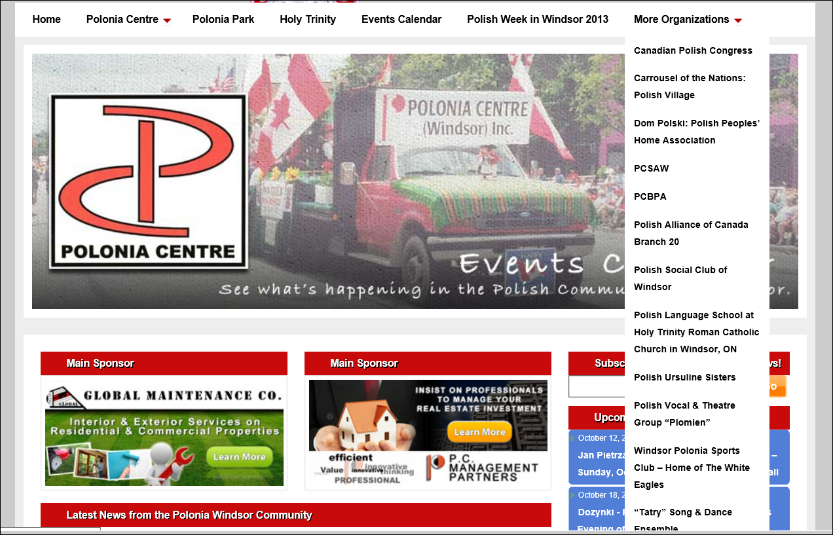
More Organizations Tab

Slide 9
Example of Organization Page - Dom Polski
Required information

Slide 10
Dom Polski page - detailed information

Slide 11
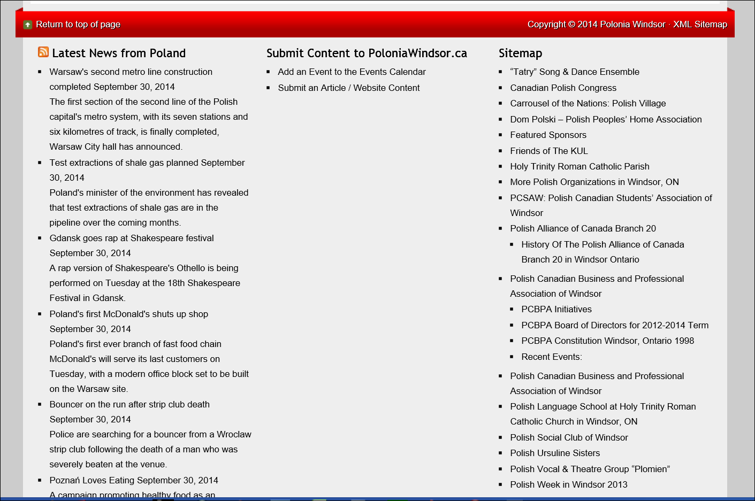
On the very bottom of each page – additional features
News (in English),
Polish Radio
Submit Contents form
Sitemap links

Slide 12
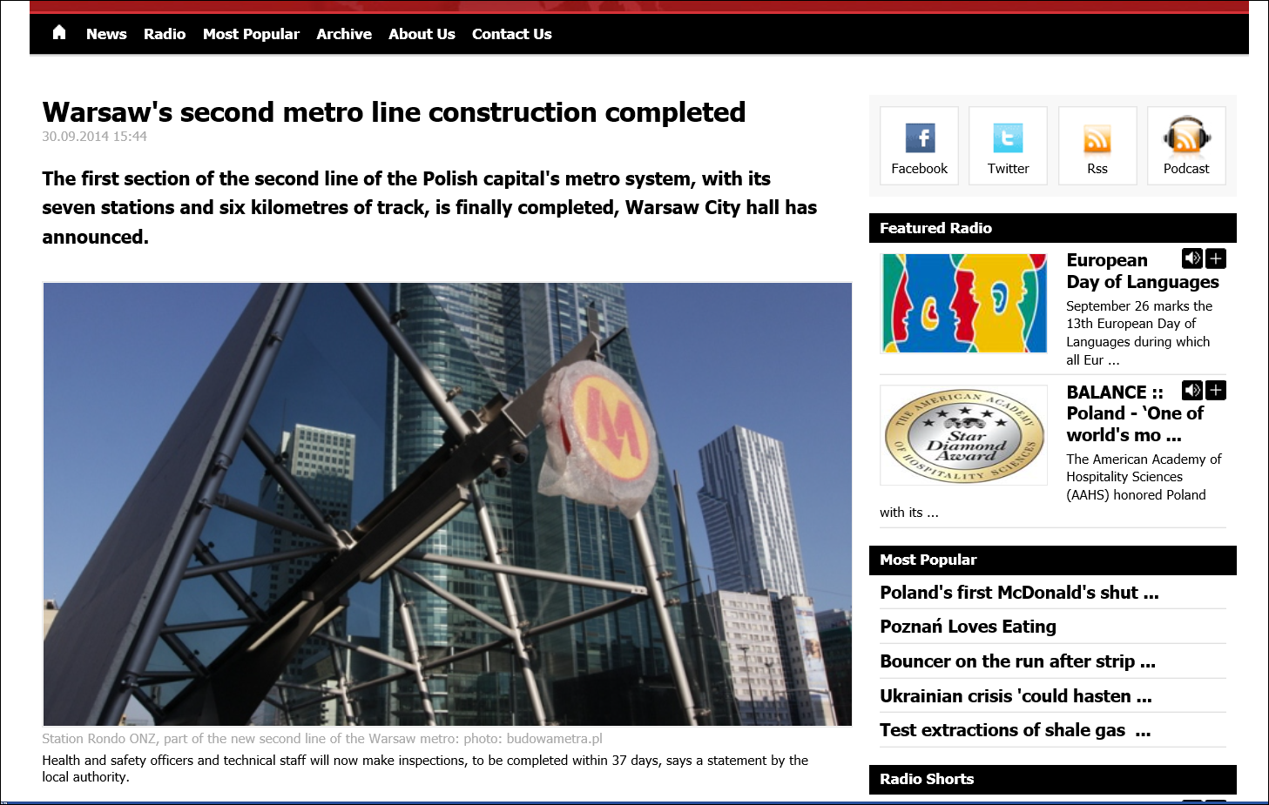
Latest News from Poland
Polish radio stations

Slide 13
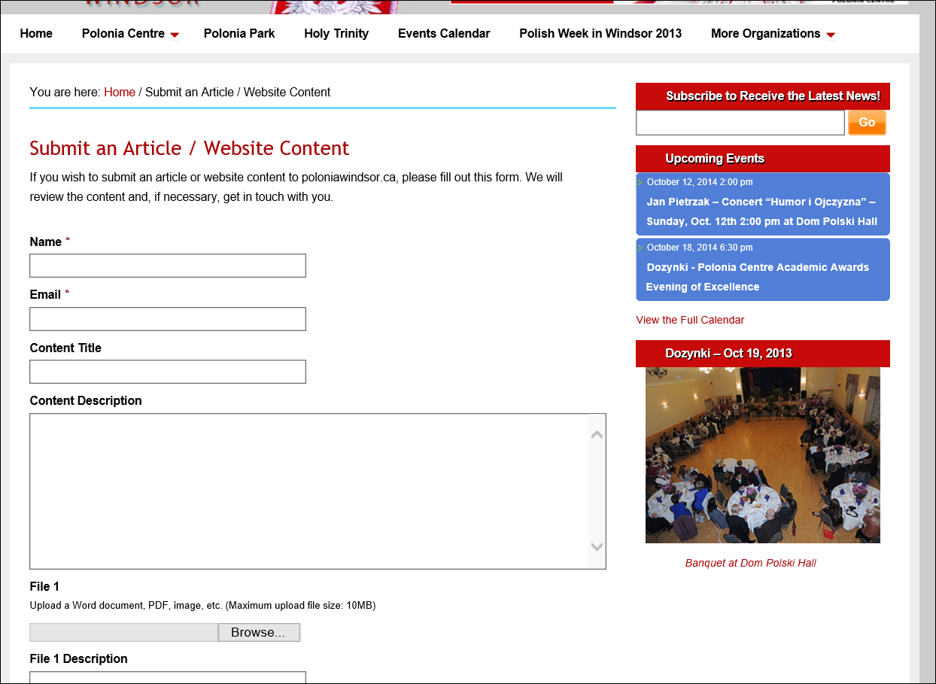
Submit Contents form – everyone is welcome to be our Website contributor!

Slide 14
OUR SPONSORS:
Polonia Centre (Windsor) Inc.
Global Maintenance Co.
P.C. Management Partners
PoloniaWindsor.ca Web site contacts:
Coordinator: Victor Wolanski
Web Master: Robert Lewicki of Sticki Marketing
Writer/ Editor: Maria Wojewnik
- THANK YOU -

