Slide 1
Nativity - Jasełka 2013
ANNUAL PERFORMANCE BY STUDENTS OF THE POLISH LANGUAGE SCHOOL IN WINDSOR
WHEN: SECOND SUNDAY OF DECEMBER, 3:00 PM
LOCATION: DOM POLSKI HALL OR AT THE HOLY TRINITY CHURCH
PROGRAM: PERFORMANCE, CHRISTMAS CAROLS SINGINGS
AND VISIT OF SWIĘTY MIKOŁAJ WITH GIFTS FOR
ALL THE CHILDREN IN THE AUDIENCE
ADMISSION FREE

Slide 2
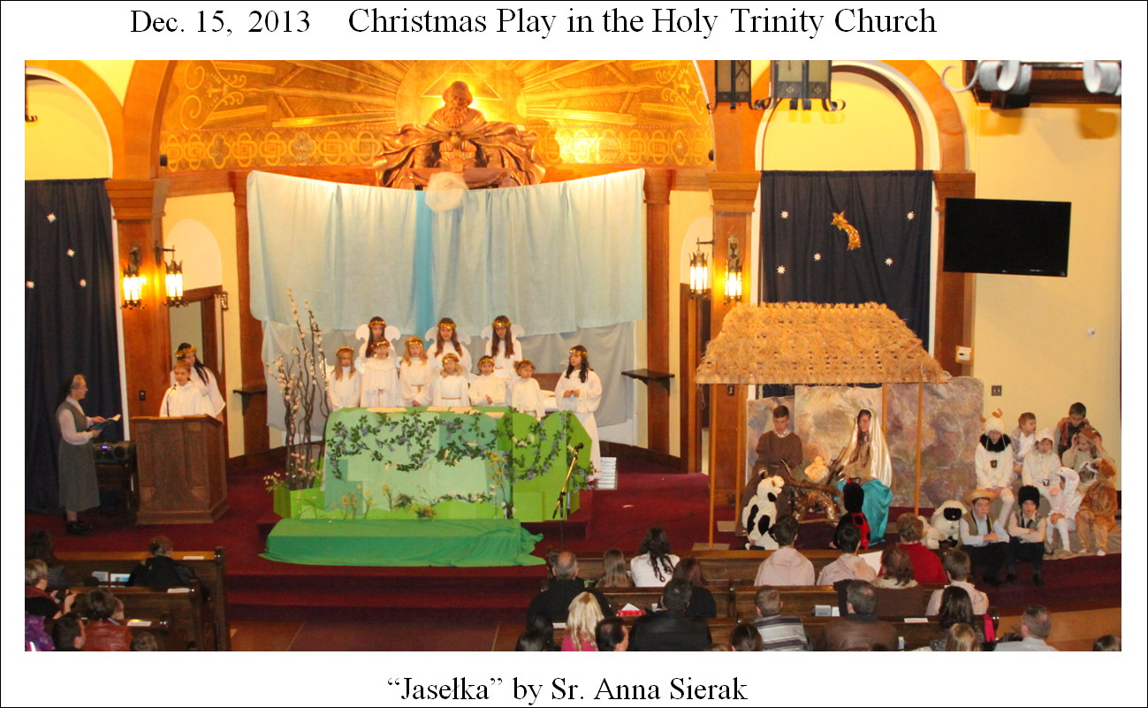

Slide 5
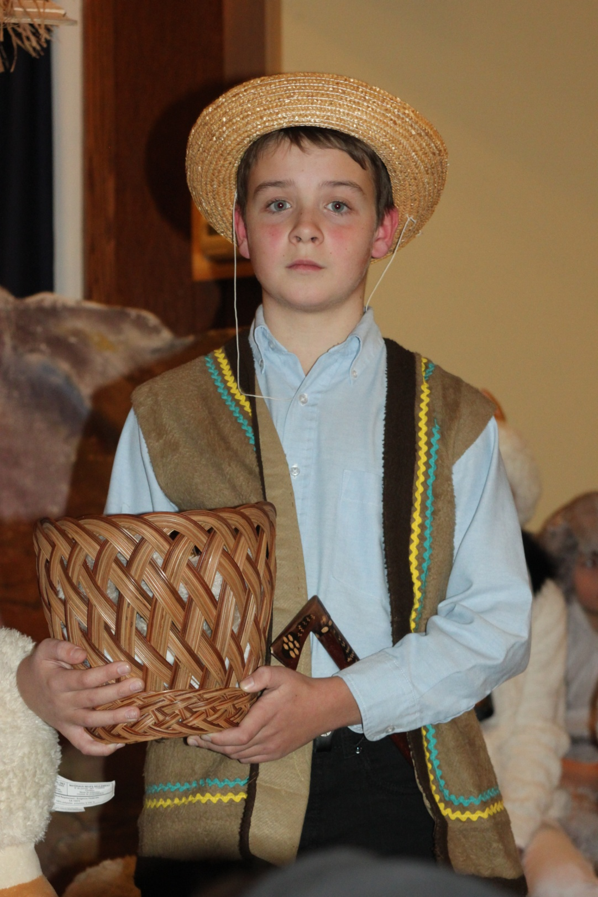

Slide 6
